Slide 1
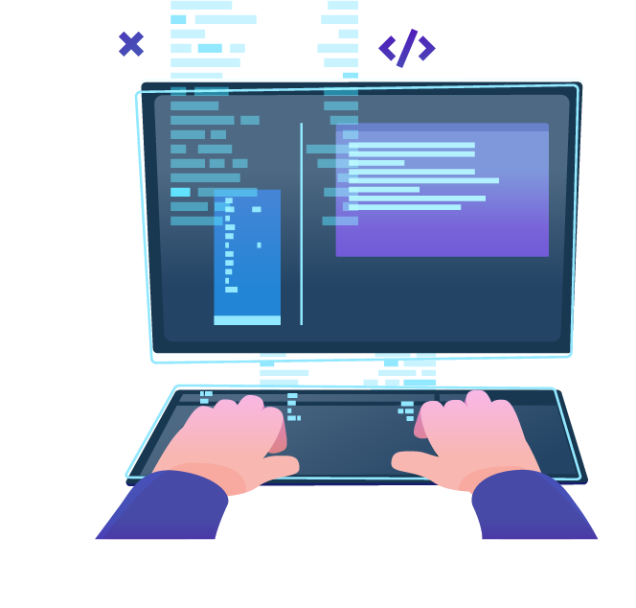
JS Syntax Fundamentals
Syntax, Conditional Statements, Loops, Data Type and Variables, Array
SoftUni Team
Technical Trainers
Software University
https://softuni.bg

Slide 2
Table of Contents
JavaScript Syntax
Data Types and Variables
Conditional Statements
Loops
Arrays
Text Processing
Debugging
2
Notes:
2

Slide 3
Have a Question?
sli.do
#js-front-end
Notes:
3

Slide 4

JavaScript Overview
Definition, Execution, IDE Setup

Slide 5
What is JavaScript?
JavaScript (JS) is a high-level programming language
One of the core technologies of the World Wide Web
Enables interactive web pages and applications
Can be executed on the server and on the client
Features:
C-like syntax (curly-brackets, identifiers, operator)
Multi-paradigm (imperative, functional, OOP)
Dynamic typing

Slide 6
Dynamic Programming Language
JavaScript is a dynamic programming language
Operations otherwise done at compile-time can be done at run-time
It is possible to change the type of a variable or add new properties or methods to an object while the program is running
In static programming languages, such changes are normally not possible

Slide 7


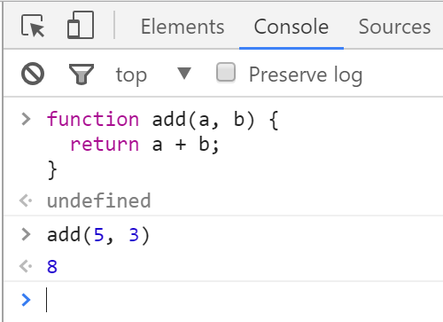
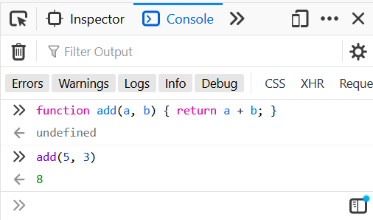
Chrome Web Browser
Developer Console: [F12]

Slide 8
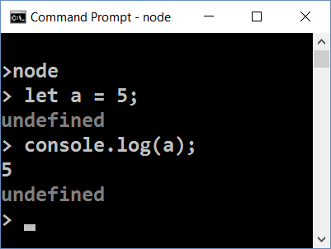
Node.js
What is Node.js?
Server-side JavaScript runtime
Chrome V8 JavaScript engine
NPM package manager
Install node packages

Slide 9
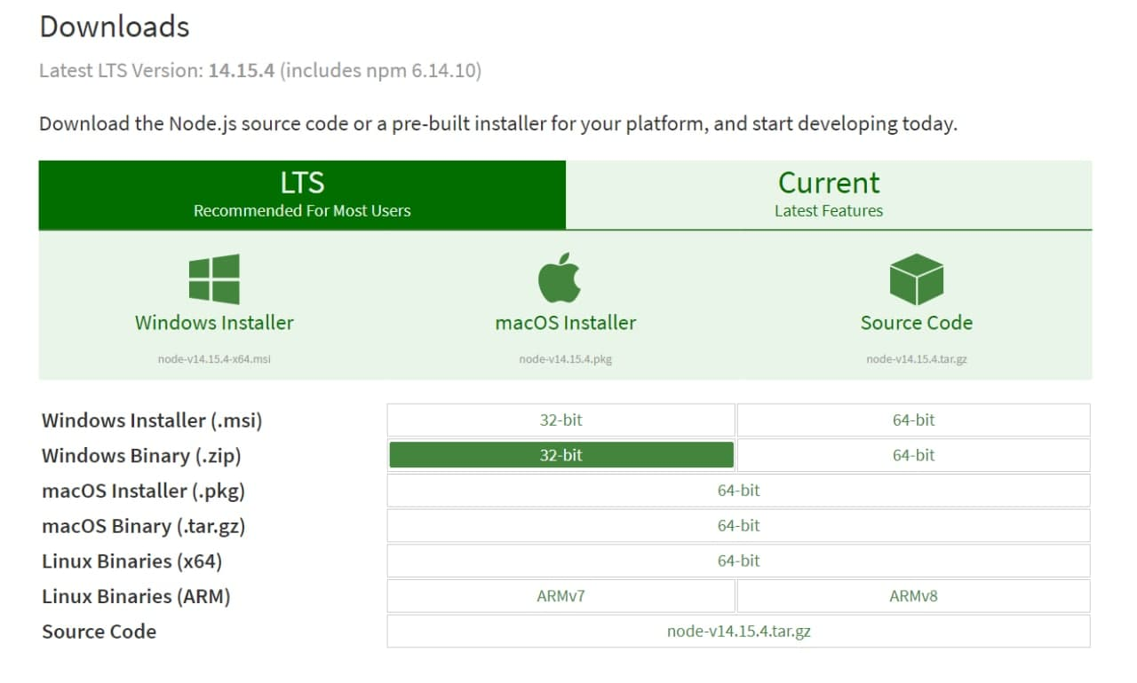
Install the Latest Node.js

Slide 10
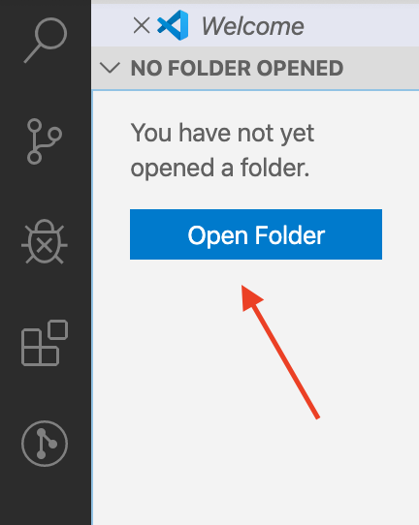
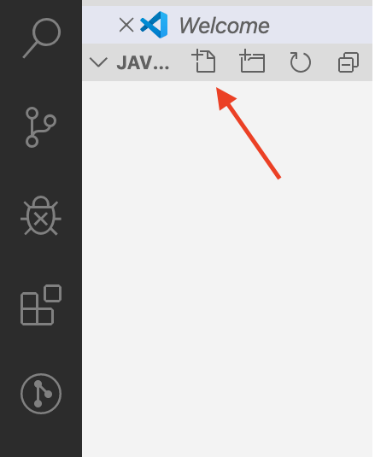
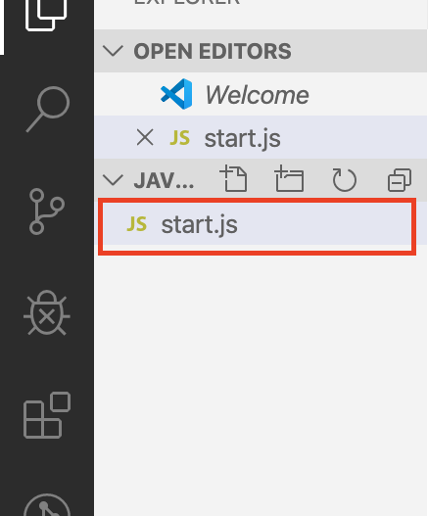
Using Visual Studio Code
Visual Studio Code is powerful text editor for JavaScript and other projects
In order to create your first project:

Slide 11

JavaScript Syntax
Functions, Operators, Input and Output

Slide 12
JavaScript Syntax
C-like syntax (curly-brackets, identifiers, operator)
Defining and Initializing variables:
Conditional statement:
Variable name
Declare a variable with let
let a = 5;
let b = 10;
Variable value
if (b > a) {
console.log(b);
}
Body of the conditional statement

Slide 13
Functions and Input Parameters
In order to solve different problems, we are going to use functions and the input will come as parameters
A function is similar to a procedure, that executes when called
declaration
parameters
function solve (num1, num2) { //some logic } solve(2, 3);
calling the function

Slide 14
Printing to the Console
We use the console.log() method to print to console:
Text can be composed easier using interpolated strings:
To format a number, use the toFixed() method (converts to string):
function solve (name, grade) {
console.log('The name is: ' + name + ', grade: ' + grade); } solve('Peter', 3.555);
//The name is: Peter, grade: 3.555
console.log(`The name is: ${name}, grade: ${grade}`);
Number of decimal places
grade.toFixed(2); //The name is: Petar, grade: 3.56

Slide 15

Data Types and Variables
Definition and Examples

Slide 16
What is a Data Type?
A data type is a classification that specifies what type of operations can be applied to it and the way values of that type are stored
After ECMAScript 2015 there are seven primitive data types:
Seven primitive: Boolean, null, undefined, Number, String, Symbol, BigInt
and Objects (including Functions and Arrays)

Slide 17
Examples
Symbol
undefined
String
null
Data Types
Boolean
Array
Number
Object
let number = 10; // Number
let person = {name: 'George', age: 25}; // Object
let array = [1, 2, 3]; // Array
let isTrue = true; // Boolean
let name = 'George'; // String
let empty = null; // null
let unknown = undefined; // undefined

Slide 18
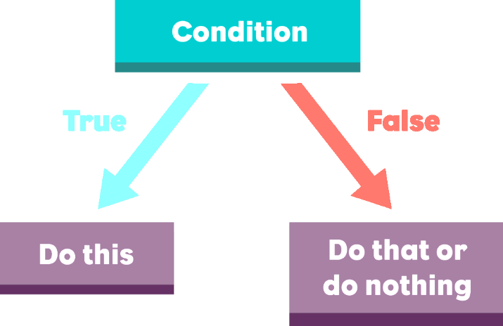
Conditional Statements
Implementing Control-Flow Logic

Slide 19
Arithmetic Operators
Arithmetic operators - take numerical values (either literals or variables) as their operands
Return a single numerical value
Addition (+)
Subtraction (-)
Multiplication (*)
Division (/)
Remainder (%)
Exponentiation (**)
let a = 15;
let b = 5;
let c;
c = a + b; // 20
c = a - b; // 10
c = a * b; // 75
c = a / b; // 3
c = a % b; // 0
c = a ** b;//15⁵ = 759375c

Slide 20

Comparison Operators
console.log(1 == '1'); // true
console.log(1 === '1'); // false
console.log(3 != '3'); // false
console.log(3 !== '3'); // true
console.log(5 < 5.5); // true
console.log(5 <= 4); // false
console.log(2 > 1.5); // true
console.log(2 >= 2); // true
console.log((5 > 7) ? 4 : 10); // 10
Ternary operator

Slide 21
What is a Conditional Statement?
The if-else statement:
Do action depending on condition
You can chain conditions
let a = 5;
if (a >= 5) {
console.log(a);
}
If the condition is met, the code will execute
else {
console.log('no');
}
Continue on the next condition, if the first is not met

Slide 22
Chained Conditional Statements
The if / else - if / else… construct is a series of checks
If one condition is true, it does not proceed to verify the following conditions
let a = 5;
if (a > 10)
console.log("Bigger than 10");
else if (a < 10)
console.log("Less than 10");
else
console.log("Equal to 10");
Only "Less than 10" will be printed

Slide 23
The Switch-case Statement
Works as a series of if / else if / else if…
switch (...){
case ...: …:
// code
break;
case ...:
// code
break;
default:
// code
break;
}
The condition in the switch case is a value
List of conditions (values) for the inspection
Code to be executed if there is no match with any case

Slide 24
Logical Operators
Logical operators give us the ability to write multiple conditions in one if statement
They return a boolean result (true or false)
Operator | Description | Example
! | NOT | !false -> true
&& | AND | true && false -> false
|| | OR | true || false -> true

Slide 25
Logical Operators: Examples
Logical "AND"
Checks the fulfillment of several conditions simultaneously
Logical "OR"
Checks that at least one of several conditions is met
let a = 3;
let b = -2;
console.log(a > 0 && b > 0); // expected output: false
let a = 3;
let b = -2;
console.log(a > 0 || b > 0); // expected output: true

Slide 26
Logical Operators: Examples (2)
Logical "NOT"
Checks if a condition is not met
let a = 3;
let b = -2;
console.log(!(a > 0 || b > 0));
// expected output: false

Slide 27
Typeof Operator
The typeof operator returns a string indicating the type of an operand
const val = 5;
console.log(typeof val); // number
const str = 'hello';
console.log(typeof str); // string
const obj = {name: 'Maria', age:18};
console.log(typeof obj); // object

Slide 28

Loops
Code Block Repetition

Slide 29
What is a Loop?
The for loop:
Repeats until the condition is evaluated
The while loop:
Does the same, but has different structure
for (let i = 1; i <= 5; i++){
console.log(i)
}
Incrementation in the condition
let i = 1
while (i <= 5) {
console.log(i)
i++
}
Incrementation outside the condition

Slide 30

Working with Arrays of Elements
3
2
1
0
Arrays in JavaScript

Slide 31
What is an Array?
Arrays are list-like objects
Arrays are a reference type, the variable points to an address in memory
Elements are numbered from 0 to length - 1
Creating an array using an array literal
0
1
2
3
4
Element index
Array of 5 elements
… | … | … | … | …
Array element
let numbers = [10, 20, 30, 40, 50];

Slide 32
What is an Array?
Neither the length of a JavaScript array nor the types of its elements are fixed
An array's length can be changed at any time
Data can be stored at non-contiguous locations in the array
JavaScript arrays are not guaranteed to be dense

Slide 33
Arrays of Different Types
// Array holding numbers
let numbers = [10, 20, 30, 40, 50];
// Array holding strings
let weekDays = ['Monday', 'Tuesday', 'Wednesday',
'Thursday', 'Friday', 'Saturday', 'Sunday'];
// Array holding mixed data (not a good practice)
let mixedArr = [20, new Date(), 'hello', {x:5, y:8}];

Slide 34
Accessing Elements
Array elements are accessed using their index
Accessing indexes that do not exist in the array returns undefined
let cars = ['BMW', 'Audi', 'Opel'];
let firstCar = cars[0]; // BMW
let lastCar = cars[cars.length - 1]; // Opel
console.log(cars[3]); // undefined
console.log(cars[-1]); // undefined

Slide 35
Destructuring Syntax
Expression that unpacks values from arrays or objects, into distinct variables
The rest operator can also be used to collect function parameters into an array
let numbers = [10, 20, 30, 40, 50];
let [a, b, ...elems] = numbers;
console.log(a) // 10
console.log(b) // 20
console.log(elems) // [30, 40, 50]
Rest operator

Slide 36

For-of Loop
Iterates through all elements in a collection
Cannot access the current index
for (let el of collection) {
// Process the value here
}

Slide 37
Print an Array with For-of
let numbers = [ 1, 2, 3, 4, 5 ];
let output = '';
for (let number of numbers)
output += `${number} `;
console.log(output);
1 2 3 4 5

Slide 38

Methods
Modify the Array

Slide 39
Pop
Removes the last element from an array and returns that element
This method changes the length of the array
let nums = [10, 20, 30, 40, 50, 60, 70];
console.log(nums.length); // 7
console.log(nums.pop()); // 70
console.log(nums.length); // 6
console.log(nums); // [ 10, 20, 30, 40, 50, 60 ]

Slide 40
Push
The push() method adds one or more elements to the end of an array and returns the new length of the array
let nums = [10, 20, 30, 40, 50, 60, 70];
console.log(nums.length); // 7
console.log(nums.push(80)); // 8 (nums.length)
console.log(nums); // [ 10, 20, 30, 40, 50, 60, 70, 80 ]

Slide 41
Shift
The shift() method removes the first element from an array and returns that removed element
This method changes the length of the array
let nums = [10, 20, 30, 40, 50, 60, 70];
console.log(nums.length); // 7
console.log(nums.shift()); // 10 (removed element)
console.log(nums); // [ 20, 30, 40, 50, 60, 70 ]

Slide 42
Unshift
The unshift() method adds one or more elements to the beginning of an array and returns the new length of the array
let nums = [40, 50, 60];
console.log(nums.length); // 3
console.log(nums.unshift(30)); // 4 (nums.length)
console.log(nums.unshift(10,20)); // 6 (nums.length)
console.log(nums); // [ 10, 20, 30, 40, 50, 60 ]

Slide 43
Splice
Changes the contents of an array by removing or replacing existing elements and / or adding new elements
let nums = [1, 3, 4, 5, 6];
nums.splice(1, 0, 2); // inserts at index 1
console.log(nums); // [ 1, 2, 3, 4, 5, 6 ]
nums.splice(4, 1, 19); // replaces 1 element at index 4
console.log(nums); // [ 1, 2, 3, 4, 19, 6 ]
let el = nums.splice(2, 1); // removes 1 element at index 2
console.log(nums); // [ 1, 2, 4, 19, 6 ]
console.log(el); // [ 3 ]

Slide 44

Reverse
Reverses the array
The first array element becomes the last, and the last array element becomes the first
let arr = [1, 2, 3, 4];
arr.reverse();
console.log(arr); // [ 4, 3, 2, 1 ]

Slide 45
Join
Creates and returns a new string by concatenating all of the elements in an array (or an array-like object), separated by commas or a specified separator string
let elements = ['Fire', 'Air', 'Water']; console.log(elements.join()); // "Fire,Air,Water"
console.log(elements.join('')); // "FireAirWater"
console.log(elements.join('-')); // "Fire-Air-Water"
console.log(['Fire'].join(".")); // Fire

Slide 46
Slice
The slice() method returns a shallow copy of a portion of an array into a new array object selected from begin to end (end not included)
The original array will not be modified
let fruits = ['Banana', 'Orange', 'Lemon', 'Apple'];
let citrus = fruits.slice(1, 3);
let fruitsCopy = fruits.slice();
// fruits contains ['Banana', 'Orange', 'Lemon', 'Apple']
// citrus contains ['Orange', 'Lemon']

Slide 47
Includes
Determines whether an array contains a certain element, returning true or false as appropriate
// array length is 3
// fromIndex is -100
// computed index is 3 + (-100) = -97
let arr = ['a', 'b', 'c'];
arr.includes('a', -100); // true
arr.includes('b', -100); // true
arr.includes('c', -100); // true
arr.includes('a', -2); // false

Slide 48
IndexOf
The indexOf() method returns the first index at which a given element can be found in the array
Output is -1 if element is not present
const beasts = ['ant', 'bison', 'camel', 'duck', 'bison'];
console.log(beasts.indexOf('bison')); // 1 // start from index 2
console.log(beasts.indexOf('bison', 2)); // 4 console.log(beasts.indexOf('giraffe')); // -1

Slide 49
ForEach
The forEach() method executes a provided function once for each array element
Converting a for loop to forEach
const items = ['item1', 'item2', 'item3'];
const copy = [];
// For loop
for (let i = 0; i < items.length; i++) {
copy.push(items[i]);
}
// ForEach
items.forEach(item => { copy.push(item); });

Slide 50
Map
Creates a new array with the results of calling a provided function on every element in the calling array
let numbers = [1, 4, 9];
let roots = numbers.map(function(num, i, arr) {
return Math.sqrt(num)
});
// roots is now [1, 2, 3]
// numbers is still [1, 4, 9]

Slide 51
Find
Returns the first found value in the array, if an element in the array satisfies the provided testing function or undefined if not found
let array1 = [5, 12, 8, 130, 44]; let found = array1.find(function(element) {
return element > 10;
});
console.log(found); // 12

Slide 52
Filter
Creates a new array with filtered elements only
Calls a provided callback function once for each element in an array
Does not mutate the array on which it is called
let fruits = ['apple', 'banana', 'grapes', 'mango', 'orange']; // Filter array items based on search criteria (query)
function filterItems(arr, query) {
return arr.filter(function(el) {
return el.toLowerCase().indexOf(query.toLowerCase()) !== -1;
});
}; console.log(filterItems(fruits, 'ap')); // ['apple', 'grapes']

Slide 53

Manipulating Strings

Slide 54
Concatenating
Use the "+" or the "+=" operators
Use the concat() method
let text = "Hello" + ", ";
// Expected output: "Hello, "
text += "JS!"; // "Hello, JS!"
let greet = "Hello, ";
let name = "John";
let result = greet.concat(name);
console.log(result); // Expected output: "Hello, John"

Slide 55
Searching for Substrings
indexOf(substr)
lastIndexOf(substr)
let str = "I am JavaScript developer";
console.log(str.indexOf("Java")); // Expected output: 5
console.log(str.indexOf("java")); // Expected output: -1
let str = "Intro to programming";
let last = str.lastIndexOf("o");
console.log(last); // Expected output: 11

Slide 56
Extracting Substrings
substring(startIndex, endIndex)
let str = "I am JavaScript developer";
let sub = str.substring(5, 10);
console.log(sub); // Expected output: JavaS

Slide 57
String Operations
replace(search, replacement)
let text = "Hello, john@softuni.bg, you have been using john@softuni.bg in your registration.";
let replacedText = text.replace(".bg", ".com");
console.log(replacedText); // Hello, john@softuni.com, you have been using john@softuni.bg in your registration.

Slide 58
Problem: Substring
Receives a string, a start index, and count characters
Print the substring of the received string
"ASentence", 1, 8
Sentence
"JavaScript", 4, 6
Script

Slide 59
Solution: Substring
function solve(text, startIndex, count) {
let substring = text
.substring(startIndex, startIndex + count);
console.log(substring);
}

Slide 60
Splitting and Finding
split(separator)
includes(substr)
let text = "I love fruits";
let words = text.split(' ');
console.log(words); // Expected output: ['I', 'love', 'fruits']
let text = "I love fruits.";
console.log(text.includes("fruits")); // Expected output: True
console.log(text.includes("banana")); // Expected output: False

Slide 61
Repeating Strings
repeat(count) - Creates a new string repeated count times
let n = 3;
for(let i = 1; i <= n; i++) {
console.log('*'.repeat(i));
}
// *
// **
// ***

Slide 62
Problem: Censored Words
Receives a text and a single word
Find all occurrences of that word in the text and replace them with the corresponding amount of '*'
A small sentence with some words,
small
A ***** sentence with some words

Slide 63
Solution: Censored Words
function solve(text, word) {
while (text.includes(word)) {
text = text.replace(word, '*'.repeat(word.length));
}
console.log(text);
}

Slide 64
Trimming Strings
Use trim() method to remove whitespaces (spaces, tabs, no-break space, etc. ) from both ends of a string
Use trimStart() or trimEnd() to remove whitespaces only at the beginning or at the end
let text = " Annoying spaces ";
console.log(text.trim()); // Expected output: "Annoying spaces"
let text = " Annoying spaces ";
text = text.trimStart(); text = text.trimEnd();
console.log(text); // Expected output: "Annoying spaces"

Slide 65
Starts With/Ends with
Use startsWith() to determine whether a string begins with the characters of a specified substring
Use endsWith() to determine whether a string ends with the characters of a specified substring
let text = "My name is John";
console.log(text.startsWith('My')); // Expected output: true
let text = "My name is John";
console.log(text.endsWith('John')); // Expected output: true

Slide 66
Padding at the Start and End
Use padStart() to add to the current string another substring at the start until a length is reached
Use padEnd() to add to the current string another substring at the end until a length is reached
Receives length and substring
let text = "010";
console.log(text.padStart(8, '0')); // Expected output: 00000010
let sentence = "He passed away";
console.log(sentence.padEnd(20, '.'));
// Expected output: He passed away......

Slide 67
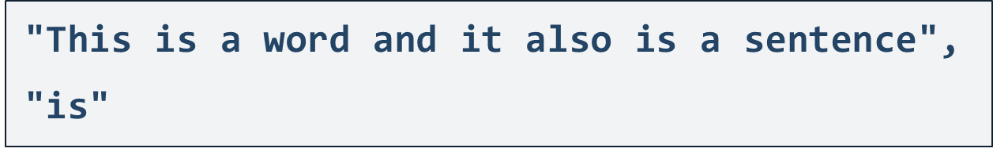
Problem: Count String Occurrences
Receive a text and a word that you need to search
Find the number of all occurrences of that word and print it
2

Slide 68
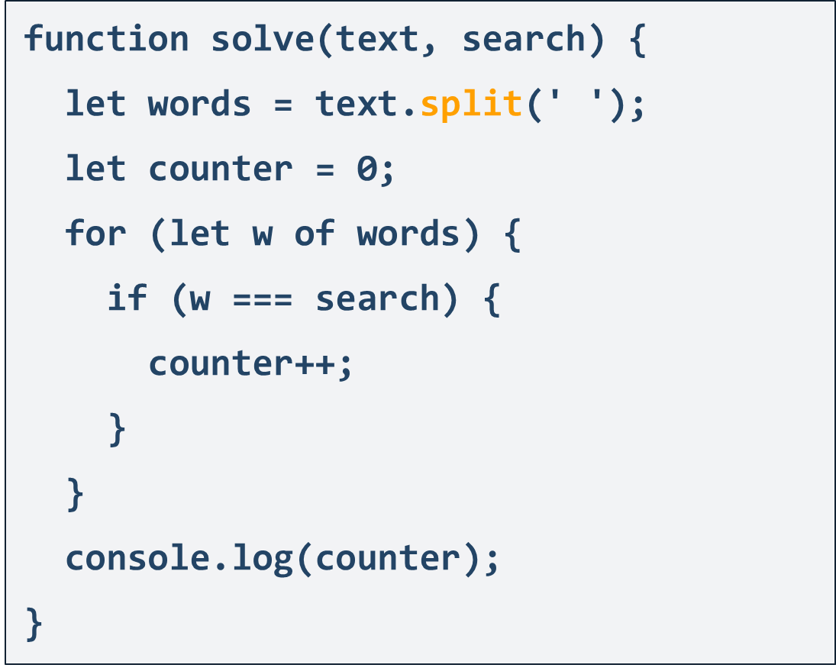
Solution: Count String Occurrences

Slide 69

Live Exercises

Slide 70

Debugging Techniques
Strict Mode, IDE Debugging Tools

Slide 71
Strict Mode
Strict mode limits certain "sloppy" language features
Silent errors will throw Exception instead
Enabled by default in modules
'use strict'; // File-level
mistypeVariable = 17; // ReferenceError
'use strict'
function strict() {
'use strict'; // Function-level
mistypeVariable = 17;
}
'use strict'

Slide 72
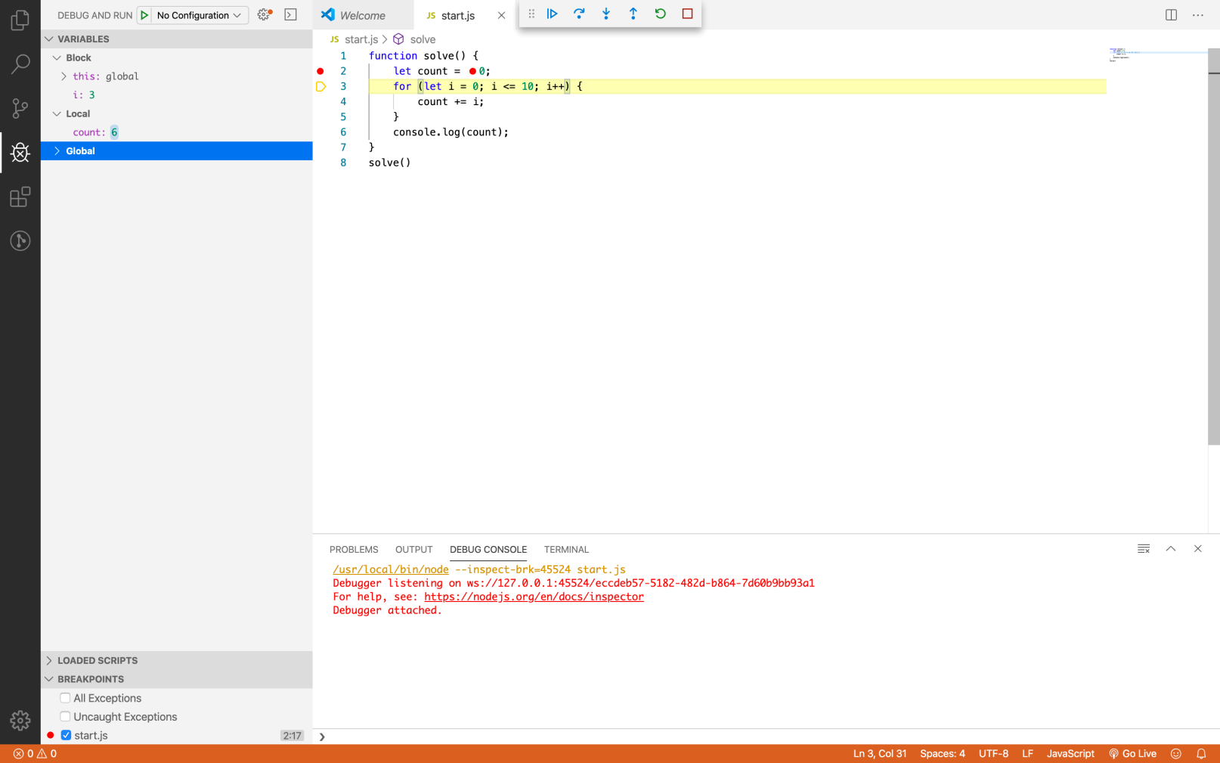
Debugging in Visual Studio Code
Visual Studio Code has a built-in debugger
It provides:
Breakpoints
Ability to trace the code execution
Ability to inspect variables at runtime

Slide 73
Using the Debugger in Visual Studio Code
Start without Debugger: [Ctrl+F5]
Start with Debugger: [F5]
Toggle a breakpoint: [F9]
Trace step by step: [F10]
Force step into: [F11]

Slide 74
Summary
…
…
…
JS is a high-level programming language
Conditional statement – If-else, Switch-case
Loops – For-loop, While-loop
Data Types
String, Number, Boolean, Null, Undefined
Array
Methods
Associative Array

Slide 75
Questions?
Notes:
75

Slide 76














SoftUni Diamond Partners

Slide 77

Educational Partners

Slide 78

License
This course (slides, examples, demos, exercises, homework, documents, videos and other assets) is copyrighted content
Unauthorized copy, reproduction or use is illegal
© SoftUni – https://about.softuni.bg/
© Software University – https://softuni.bg
Notes:
78

Slide 79
Trainings @ Software University (SoftUni)
Software University – High-Quality Education, Profession and Job for Software Developers
softuni.bg, about.softuni.bg
Software University Foundation
softuni.foundation
Software University @ Facebook
facebook.com/SoftwareUniversity
Software University Forums
forum.softuni.bg
Notes:
79

